Slide 1
University Physics, lecture 15 Lesson 10: Mechanical waves
Teacher: Dr. Paul Briard

Slide 2
Contents:
Introduction
Propagation of a SHM
The diffraction phenomenon
The interference phenomenon
The standing waves
The Doppler effect

Slide 3
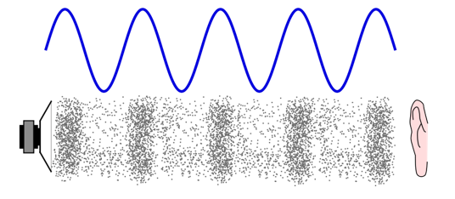
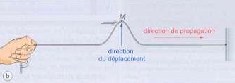

Introduction: examples of mechanical waves
Propagation of sound
Perturbation on a rope
http://www.alloprof.qc.ca/BV/pages/s1134.aspx
https://docplayer.fr/47375713-Caracteristiques-des-ondes.html
Waves at the surface of water
http://villemin.gerard.free.fr/aScience/Physique/ONDULAT/Onde.htm

Slide 4
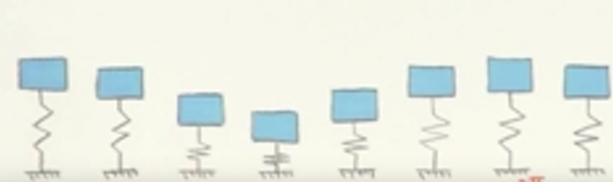
The wave
A mechanical wave is the propagation of a perturbation (i.e. disturbance).
A wave can be the propagation of a SHM. Such wave can be described as follows:
A wave can be the propagation of other kinds of perturbation. A wave can be periodic or not periodic.
Montrer avec appareil (prendre etudiant)
https://www.youtube.com/watch?v=tsNmQ9Utn9M

Slide 5

Propagation of a wave
A mechanical wave need a medium to propagate: a string, a spring, water, air molecules…
Definition of a medium: a group of particles which can move by propagate a mechanical wave.
If there is no medium, a mechanical wave can’t propagate. For instance, the sound can’t propagate in vacuum !
Unlike in Star Wars movies, there is no sound of laser shoots and explosion propagating outer space !
http://dailynewsdig.com/is-it-possible-to-hear-sound-in-outer-space/

Slide 6
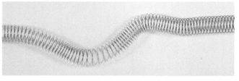
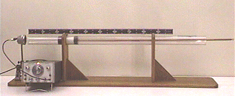
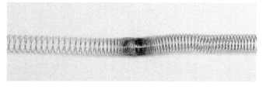
2 kinds of waves: transverse and longitudinal
The transverse waves are waves where the motion of the perturbation is perpendicular to the wave propagation. Examples:
The longitudinal waves are waves where the perturbation is along the direction of propagation. Examples:
Propagation
https://beatricepresson.weebly.com/5-ondes-meacutecaniques.html
Device with sound waves produced by an oscillating plunger
Propagation
https://physicslearning2.colorado.edu/QOTWSite/services/demos/demosh3/h3-22.htm
https://beatricepresson.weebly.com/5-ondes-meacutecaniques.html

Slide 7
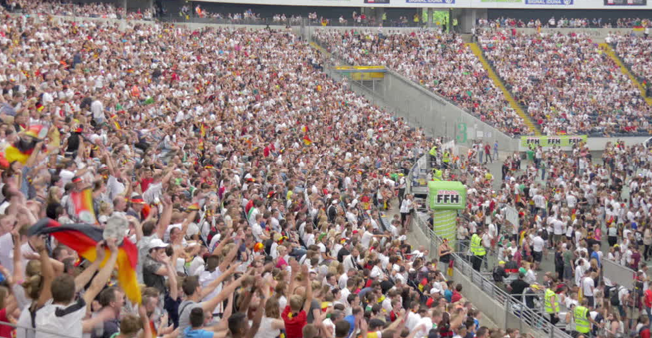
Is a Mexican wave in football stadiums a mechanical wave ? Which kind of wave it is (transverse or longitudinal) ?
http://footage.framepool.com/en/shot/403167842-mexican-wave-commerzbank-arena-wc-2014-national-color

Slide 8
2. Propagation of a simple harmonic motion

Slide 9
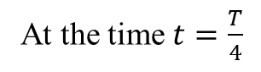
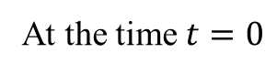
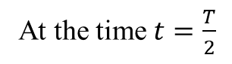
Propagation of a SHM, i.e. the sinusoidal waves
y
String
0
x
At the time $t=0$
Oscillator
y
String
At the time $t=\frac{T}{4}$
0
x
Oscillator
String
0
x
At the time $t=\frac{T}{2}$
Oscillator

Slide 10
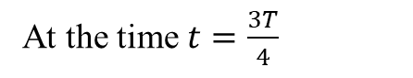
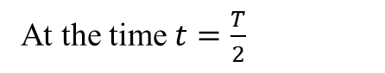
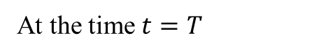
Propagation of a SHM, i.e. the sinusoidal waves
y
String
At the time $t=\frac{T}{2}$
0
x
Oscillator
y
String
0
x
At the time $t=\frac{3T}{4}$
Oscillator
y
String
0
x
At the time $t=T$
Oscillator

Slide 11
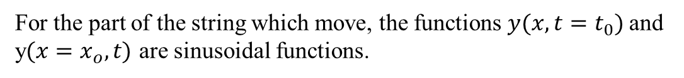
Propagation of a SHM, i.e. the sinusoidal waves
y
String
0
x
Oscillator
For the part of the string which move, the functions $y(x,t=t_{0})$and y$(x=x_{o},t)$ are sinusoidal functions.

Slide 12
Propagation of a SHM, i.e. the sinusoidal waves
y
String
At the time $t=\frac{T}{2}$
0
x
Oscillator
y
String
0
x
At the time $t=\frac{3T}{4}$
Oscillator
y
String
0
x
At the time $t=T$
Oscillator

Slide 13
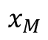
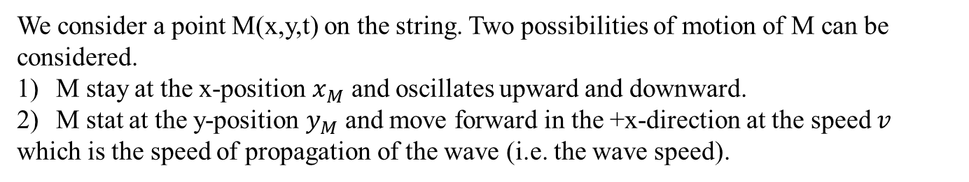
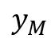
Propagation of a SHM, i.e. the sinusoidal waves
Sinusoidal perturbation of a string:
y
Propagation
M
$$y_{M}$$
String
0
x
$$x_{M}$$
Oscillator
We consider a point M(x,y,t) on the string. Two possibilities of motion of M can be considered.
M stay at the x-position $x_{M}$ and oscillates upward and downward.
M stat at the y-position $y_{M}$ and move forward in the +x-direction at the speed $v$
which is the speed of propagation of the wave (i.e. the wave speed).

Slide 14
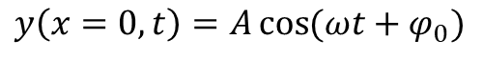
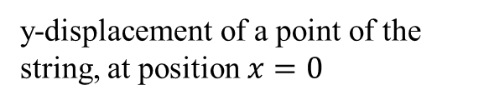
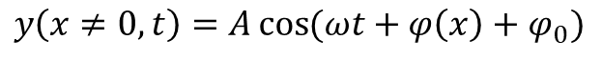
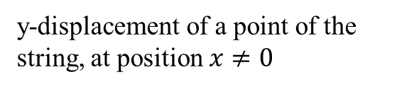
Propagation of a SHM, i.e. the sinusoidal waves
Sinusoidal perturbation of a string:
y
M
0
x
Oscillator
angular frequency
Amplitude
Phase offset
y-displacement of a point of the string, at position $x=0$
$$y\left(x=0,t\right)=A\cos{(ωt+φ_{0})}$$
y-displacement of a point of the string, at position $x≠0$
$$y\left(x≠0,t\right)=A\cos{(ωt+φ\left(x\right)+φ_{0})}$$
$φ\left(x\right)$ is the phase difference between motions $y\left(x≠0,t\right)$ and $y\left(x=0,t\right)$

Slide 15
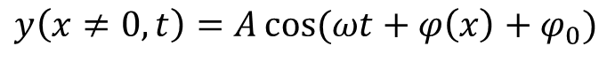
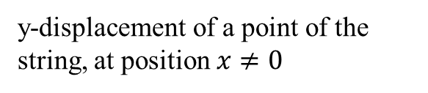
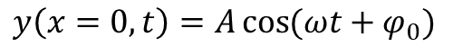
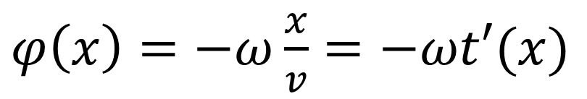
Propagation of a SHM, i.e. the sinusoidal waves
Propagation
y
M
0
x
$$y\left(x=0,t\right)=A\cos{(ωt+φ_{0})}$$
y-displacement of a point of the string, at position $x≠0$
$$y\left(x≠0,t\right)=A\cos{(ωt+φ\left(x\right)+φ_{0})}$$
$φ\left(x\right)$ $=−ω\frac{x}{v}=−ωt′(x)$
$v$: Speed of the propagation of the perturbation, i.e it is “the wave speed”
$t′(x)$ is the time to travel the distance $x$ at the speed $v$

Slide 16
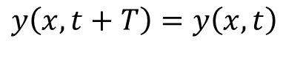
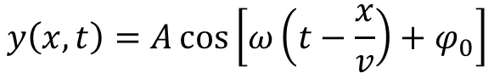
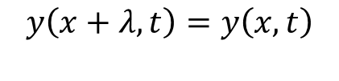
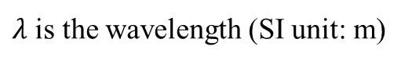
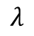
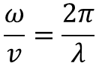
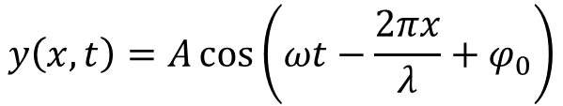
Propagation of a SHM, i.e. the sinusoidal waves
Propagation
y
M
$$λ$$
String
0
x
y-displacement of a point of the string, at position $x≠0$:
$$y\left(x,t\right)=A\cos\left[ω\left(t−\frac{x}{v}\right)+φ_{0}\right]$$
$$\frac{ω}{v}=\frac{2π}{λ}$$
$$y\left(x,t\right)=A\cos\left(ωt−\frac{2πx}{λ}+φ_{0}\right)$$
Using
$λ$ is the wavelength (SI unit: m)
$$y\left(x+λ,t\right)=y\left(x,t\right)$$
$$y\left(x,t+T\right)=y\left(x,t\right)$$

Slide 17
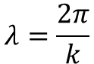
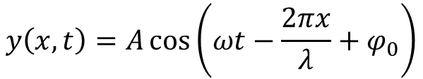
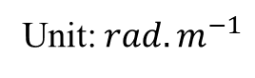
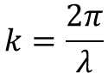
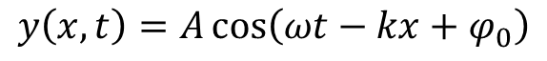
Propagation of a SHM, i.e. the sinusoidal waves
y
Propagation
$$λ=\frac{2π}{k}$$
M
0
x
This equation describes a sinusoidal wave propagating in the +x-direction:
$$y\left(x,t\right)=A\cos\left(ωt−\frac{2πx}{λ}+φ_{0}\right)$$
$$y\left(x,t\right)=A\cos\left(ωt−kx+φ_{0}\right)$$
$$k=\frac{2π}{λ}$$
Wave number:
Unit: $rad.m^{−1}$
The wave number (or angular wave number) is the number of radians per unit distance. $kx$ is an angle expressed in radians.

Slide 18
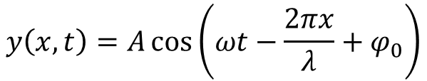
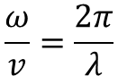
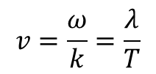
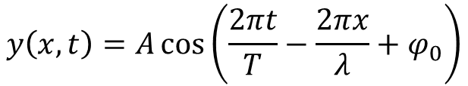
The wavelength and the wave number
$$y\left(x,t\right)=A\cos\left(ωt−\frac{2πx}{λ}+φ_{0}\right)$$
$$y\left(x,t\right)=A\cos\left(\frac{2πt}{T}−\frac{2πx}{λ}+φ_{0}\right)$$
The wavelength $λ=\frac{2π}{k}$ is a spatial period of a periodic wave.
$$\frac{ω}{v}=\frac{2π}{λ}$$
The speed of propagation of the wave is:
Using
$$v=\frac{ω}{k}=\frac{λ}{T}$$

Slide 19
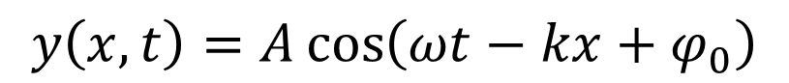
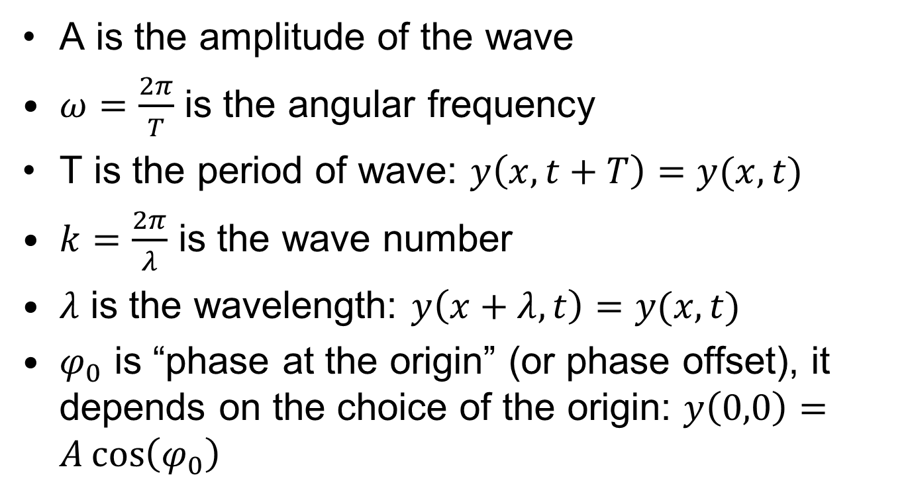
The sinusoidal wave: summary
The sinusoidal wave is the propagation of a SHM.
$$y\left(x,t\right)=A\cos\left(ωt−kx+φ_{0}\right)$$
A is the amplitude of the wave
$ω=\frac{2π}{T}$ is the angular frequency
T is the period of wave: $y\left(x,t+T\right)=y(x,t)$
$k=\frac{2π}{λ}$ is the wave number
$λ$ is the wavelength: $y\left(x+λ,t\right)=y(x,t)$
$φ_{0}$ is “phase at the origin” (or phase offset), it depends on the choice of the origin: $y\left(0,0\right)=A\cos\left(φ_{0}\right)$

Slide 20
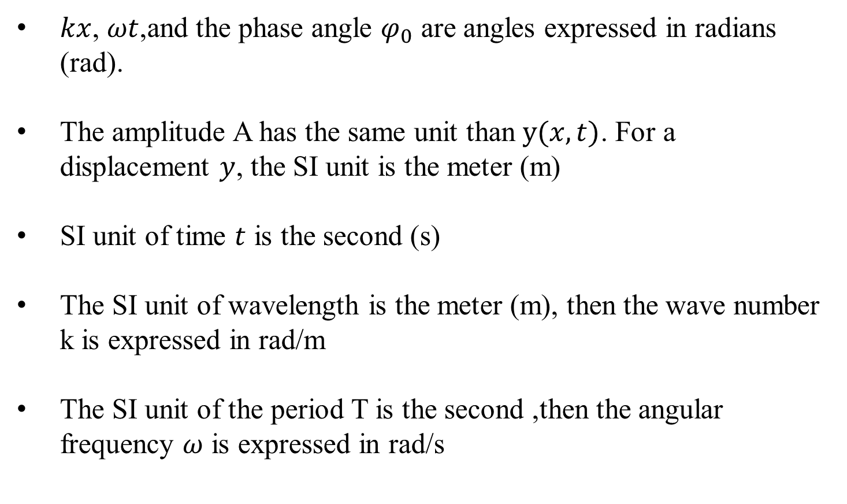
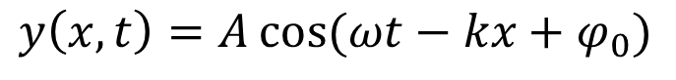
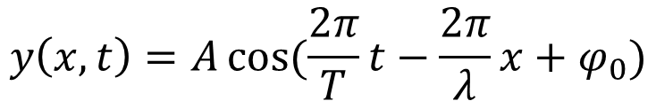
About the units
$$y\left(x,t\right)=A\cos{(ωt−kx+φ_{0})}$$
$$y\left(x,t\right)=A\cos{(\frac{2π}{T}t−\frac{2π}{λ}x+φ_{0})}$$
$kx$, $ωt$,and the phase angle $φ_{0}$ are angles expressed in radians (rad).
The amplitude A has the same unit than $y(x,t)$. For a displacement $y$, the SI unit is the meter (m)
SI unit of time $t$ is the second (s)
The SI unit of wavelength is the meter (m), then the wave number k is expressed in rad/m
The SI unit of the period T is the second ,then the angular frequency $ω$ is expressed in rad/s

Slide 21
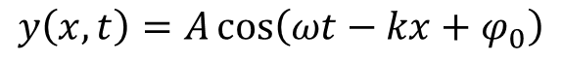
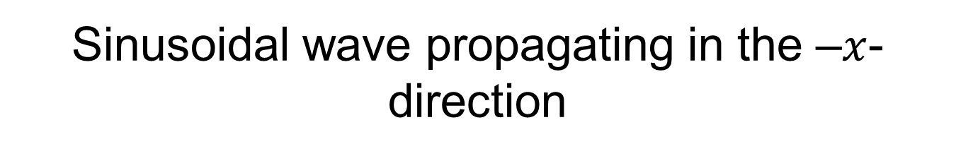
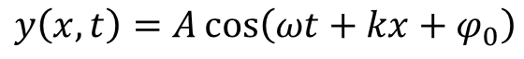
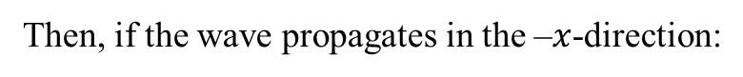
Sinusoidal wave propagating in the –$x$-direction
If the wave propagating in the +$x$-direction:
$$y\left(x,t\right)=A\cos\left(ωt−kx+φ_{0}\right)$$
Then, if the wave propagates in the –$x$-direction:
$$y\left(x,t\right)=A\cos\left(ωt+kx+φ_{0}\right)$$
y
M
x
O

Slide 22





Phase of a sinusoidal wave
$$y\left(x,t\right)=A\cos\left(ωt−kx+φ_{0}\right)$$
Propagation toward the +$x$-direction
$$y\left(x,t\right)=A\cos\left(ωt+kx+φ_{0}\right)$$
Propagation toward the -$x$-direction
The quantity $ωt±kx+φ_{0}$ is an angle, describing the phase at $\left(x,t\right)$of the sinusoidal wave (unit: rad).
At a crest of the wave, $y\left(x,t\right)=A$ then:
$ωt−kx+φ_{0}=−2π,0, 2π, 4π$ … for a propagating wave toward the +$x$ direction.
$ωt+kx+φ_{0}=−2π,0, 2π, 4π$ … for a propagating wave toward the -$x$direction.
y
Crest
String
0
x

Slide 23

Phase of a sinusoidal wave
$$y\left(x,t\right)=A\cos\left(ωt−kx+φ_{0}\right)$$
Propagation toward the +$x$-direction
$$y\left(x,t\right)=A\cos\left(ωt+kx+φ_{0}\right)$$
Propagation toward the -$x$-direction
At a trough of the wave, $y\left(x,t\right)=−A$ then:
$ωt−kx+φ_{0}=−3π,−π,π, 3π, 5π$ … for a propagating wave toward the +$x$ direction.
$ωt+kx+φ_{0}=−3π,−π,π, 3π, 5π$… for a propagating wave toward the -$x$direction.
y
trough
String
0
x

Slide 24




Phase of a sinusoidal wave
$$y\left(x,t\right)=A\cos\left(ωt−kx+φ_{0}\right)$$
$$y\left(x=0,t=0\right)=A\cos\left(φ_{0}\right)$$
The choice of the origin $\left\{x=0, t=0\right\}$ is arbitrary, so we can say, the origin is chosen such as:
$$y\left(x=0,t=0\right)=A$$
$$φ_{0}=0$$
We obtain:
$$y\left(x,t\right)=A\cos\left(ωt−kx\right)$$
But take care, if more than one wave is studied, their phase difference (and their phase difference at the origin) could be important and not ignored !

Slide 25






About wave speed
$$y\left(x,t\right)=A\cos\left(ωt−kx+φ_{0}\right)$$
if the propagate in the +$x$-direction
We consider a point of the wave (for instance a crest) which the corresponding $y\left(x,t\right)$ is constant (this point move at the velocity $v$).
$$ωt−kx+φ_{0}=constant$$
$$x=\frac{1}{k}(−constant+ωt+φ_{0})$$
$$\frac{dx}{dt}=\frac{ω}{k}=v$$
y
The wave speed is also named phase velocity or phase speed
0
x

Slide 26








Graphing a sinusoidal wave
$y\left(x,t\right)$ is a function of two variables, then we could represent two kind of 2D graphs: $y\left(x,t=t_{0}\right) and y\left(x=x_{0},t\right)$
$$y\left(x,t=t_{0}\right)=A\cos\left(ωt_{0}−kx+φ_{0}\right)$$
For instance, for $t_{0}$ such as ${ωt}_{0}+φ_{0}=0$, then
$$y\left(x,t=t_{0}\right)=A\cos\left(−kx\right)$$
$$λ=\frac{2π}{k}$$
$$y\left(x,t=t_{0}\right)=2\cos{(3x)}$$
Here $k=3 rad/m$
(if unit of $x$ is m)

Slide 27








Graphing a sinusoidal wave
$$y\left(x=x_{0},t\right)=A\cos\left(ωt−kx_{0}+φ_{0}\right)$$
For instant, at the position $x_{0}$ such as
$$−kx_{0}+φ_{0}=0$$
then
$$y\left(x=x_{0},t\right)=A\cos\left(ωt\right)$$
$$T=\frac{2π}{ω}$$
$$y\left(x=0,t\right)=2\cos{(4t)}$$
Here $ω=4 rad/s$
(If unit of time $t$ is s)
A = 2 m

Slide 28
The sound waves
In a sound wave, the propagating perturbation is the fluctuation of the local pressure.
http://www.alloprof.qc.ca/BV/pages/s1134.aspx

Slide 29
3. The diffraction phenomenon

Slide 30

Wave propagation in 1 dimension (1D), 2 dimensions (2D), 3 dimensions (3D)
Example of 1D propagation (1D waves): transverse wave on a spring
Example of 2D propagation (2D waves): waves at the surface of water
Example of 3D propagation (3D waves): the sound
https://saylordotorg.github.io/text_general-chemistry-principles-patterns-and-applications-v1.0/s10-01-waves-and-electromagnetic-radi.html
All the directions of propagation draw a surface
All the directions of propagation draw a volume

Slide 31








Propagation of sinusoidal wave from a source point: introduction
$$z$$
$$r$$
$$P$$
source point
$$x$$
$$S$$
$$y$$
At the point source S a sinusoidal perturbation is generated:
$$u\left(t\right)=u_{0}\cos\left(ωt+φ_{0}\right)$$
At the point P far from S at the distance $r=\sqrt{x^{2}+y^{2}+z^{2}}$, the sinusoidal perturbation is propagated
$$u_{p}\left(r,t\right)=u_{0}\cos\left(ωt−kr+φ_{0}\right)$$
At a time $t_{0}$, what is the shape of all the points $\left\{x,y,z\right\}$with the same phase $ωt_{0}−kr+φ_{0}$ ?
The sphere of radius r
This sphere is a wave front

Slide 32


Some examples of wave fronts
Sound waves propagating in 3 dimensions (spherical wave fronts, but far from the source of the wave ,they can be considered as plane wave fronts)
Circular wave fronts
https://sites.google.com/a/simplescience.info/www/science/vibrationsproducewaves
http://slideplayer.com/slide/5683513/
Linear wave fronts produced by vibration

Slide 33

Some examples of wave fronts
https://www.nasa.gov/mission_pages/galex/20070815/f.html
Shock waves generated by a bullet passing through air and break the sound barrier (i.e. it moves faster that the sound).
The wave front shape is conical and the waves are named “bullet bow shock wave”.
33

Slide 34

Some examples of wave fronts
https://www.dreamstime.com/stock-photo-angry-teacher-megaphone-shouting-scared-student-blown-away-wave-science-formulas-women-stressed-math-negative-human-image91480534
Are the wave fronts of sound waves which come from a megaphone spherical or not spherical ?

Slide 35







The wave front
$$y$$
A spherical wave front
The wave is described by the function:
$$u\left(r,t\right)=u_{0}\cos\left(ωt−kr+φ_{0}\right)$$
$$z$$
$$x$$
$$r=\sqrt{x^{2}+y^{2}+z^{2}}$$
http://www.sciencenanum.net/physics/wave/mechanical_02_05.html
Spherical wave fronts propagating in 3 dimensions.
The perturbation is written $u(x,t)$instead of $y\left(x,t\right)$because the wave in not the propagation of a displacement in the y-direction (it could be a sound wave for instance)

Slide 36





The wave front
A circular wave front
$$y$$
The wave is described by the function:
$$x$$
$$u\left(r,t\right)=u_{0}\cos\left(ωt−kr+φ_{0}\right)$$
$$r=\sqrt{x^{2}+y^{2}}$$
Perturbation is a displacement in the z-direction (for instance, waves at the surface of water):
Circular wave fronts propagating in 2 dimensions.
$$z\left(r,t\right)=z_{0}\cos\left(ωt−kr+φ_{0}\right)$$

Slide 37

The wave front
The wave front is a set of points of the wave which have the same phase.
The direction of propagation of a wave in a point of space and its wave front at this point are perpendicular.
For instance (wave fronts can have other shape):
37

Slide 38
Introduction to the diffraction and Huygens’s principle
https://sites.google.com/a/simplescience.info/www/science/vibrationsproducewaves
Diffraction of waves at the surface of water by an aperture

Slide 39
End of lecture 15

